Slide 1
Figure Collection

Slide 2
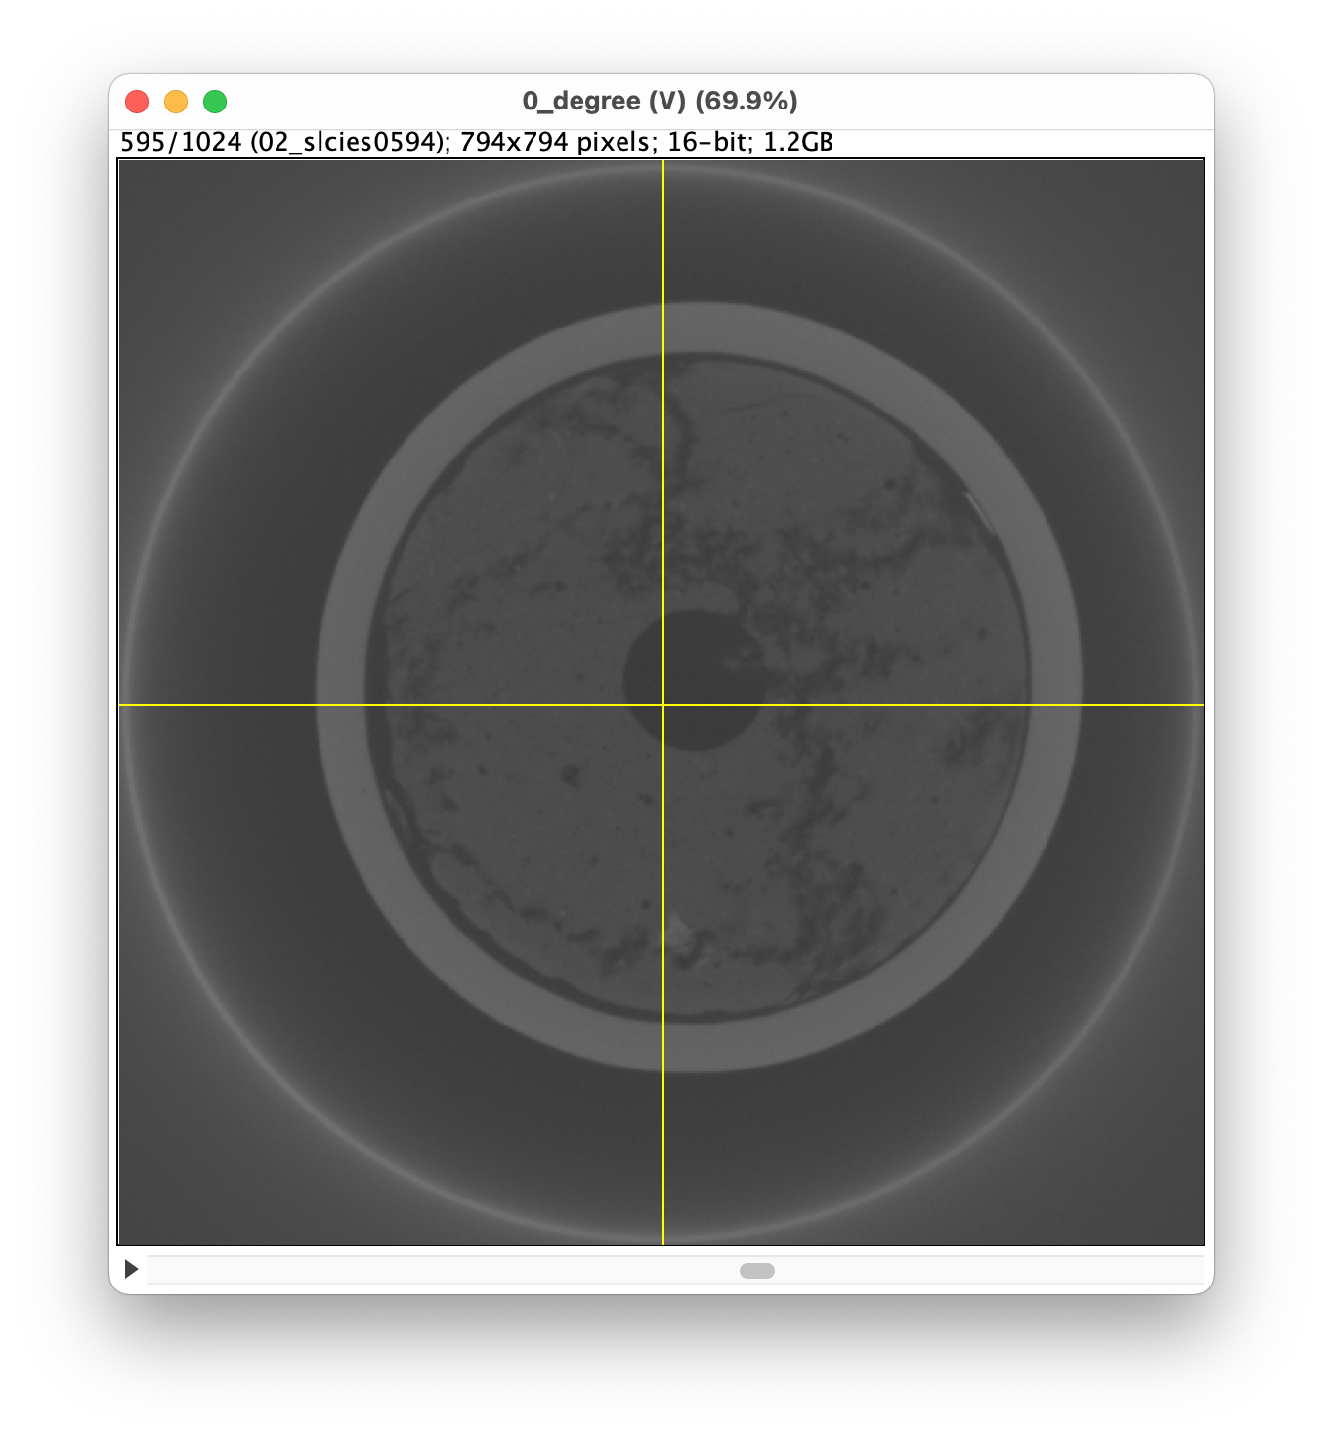
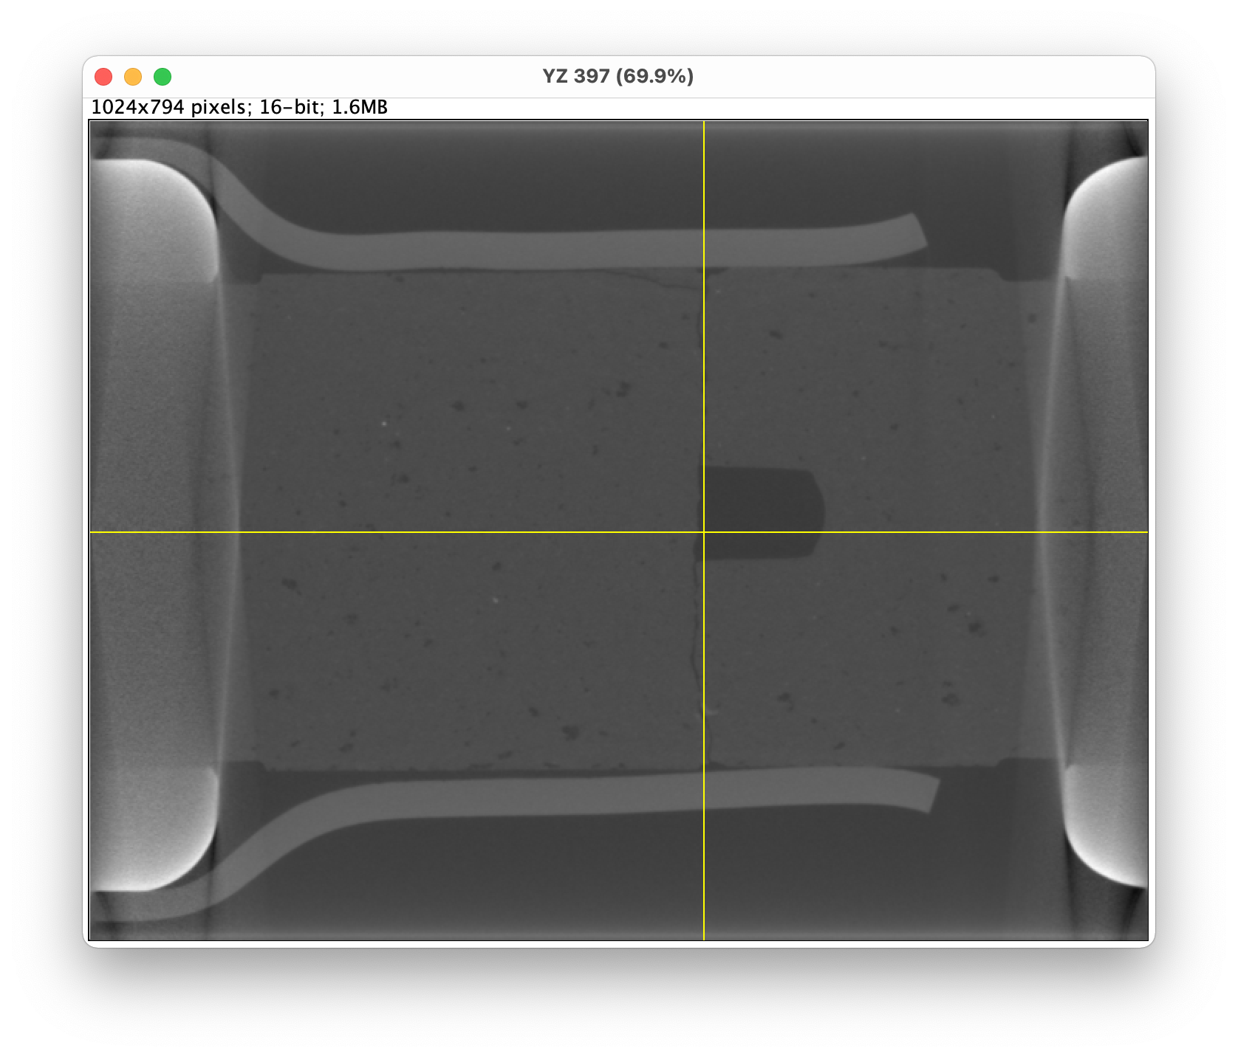
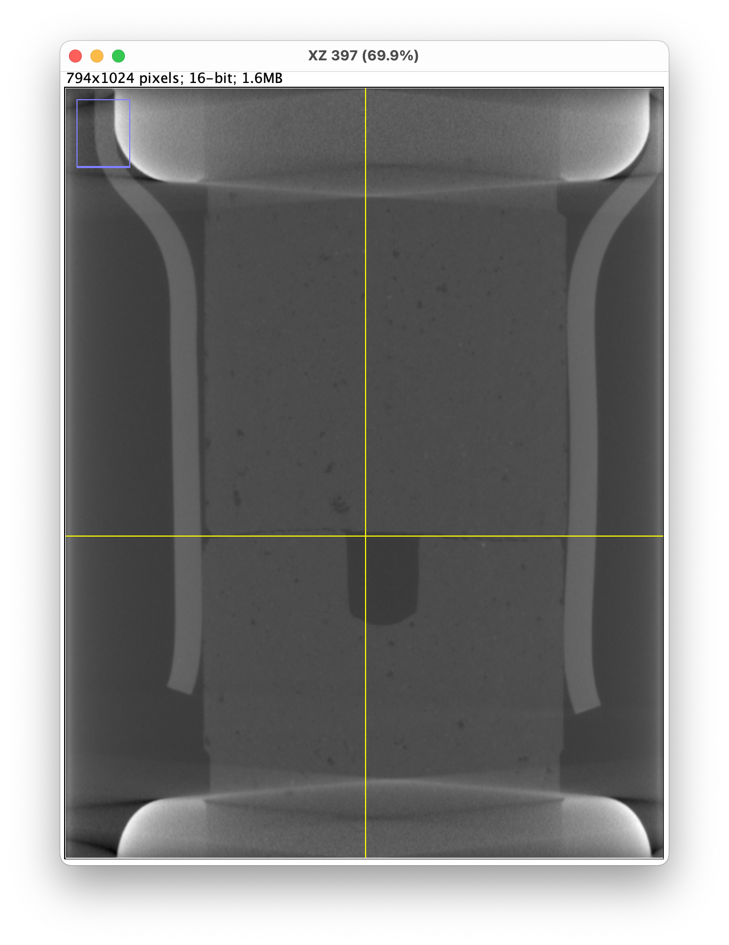
Deciding on the slices
Middle fracture slice # 595

Slide 3
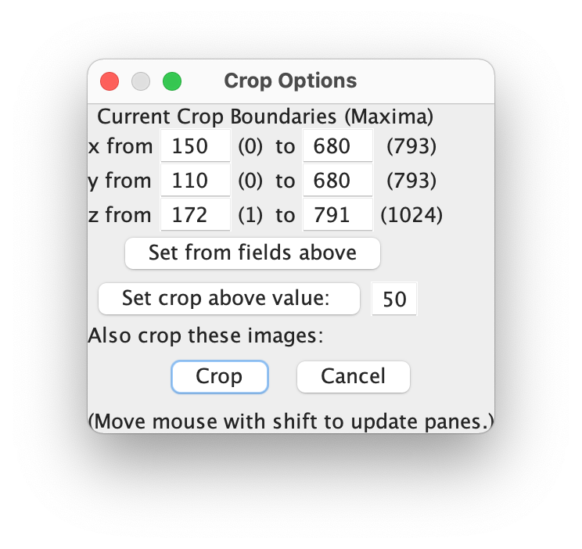
3D cropping values for degree_0
Notes:
This results in 620 slices

